Slide 1
Terminal Galaxy
(Title subject to change)

Slide 2
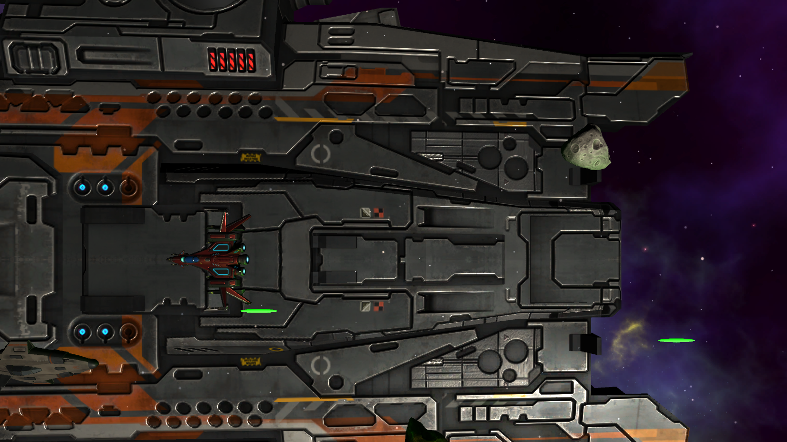
Scrolling Shooter:
Unity3D
6 Levels
6 Unique Enemies

Slide 3




The Tools
GitHub
Unity
C#
Android SDK
Private, public, or open source, all repositories are equipped with tools to help you host, version, and release code.
Powerful Game development platform. Fast and easy to learn.
The many innovations in C# enable rapid application development while retaining the expressiveness and elegance of C-style languages.
Used to port game developed in Unity to Android devices

Slide 4

The Goals
Side Scrolling Shoot’em
6 Playable levels
6 Unique Enemies
Playable on Web
Playable on Mobile
2+ Power-Ups

Slide 5
Milestones
Weekly goals
Project Setup
Level Prototype
Finalize
Enemy Prototype
1st Playable
Prep Delivery
Setting up GitHub/Unity and learning
Work on 6 level prototype
Iron out any remaining bugs and prepare for submission
Week 1 | Week 2 | Week 3 | Week 4 | Week 5 | Week 6
Work on the 6 enemies
Getting the game fully playable on platforms
Submit finished project

Slide 6
Why?
Great team building experience
Chance to pick up a new language, C#
Working on a project with time constraints and goals is good experience for exposure to the real world
Sufficiently complex for this assignment
Will have a tangible working product when complete

Slide 7
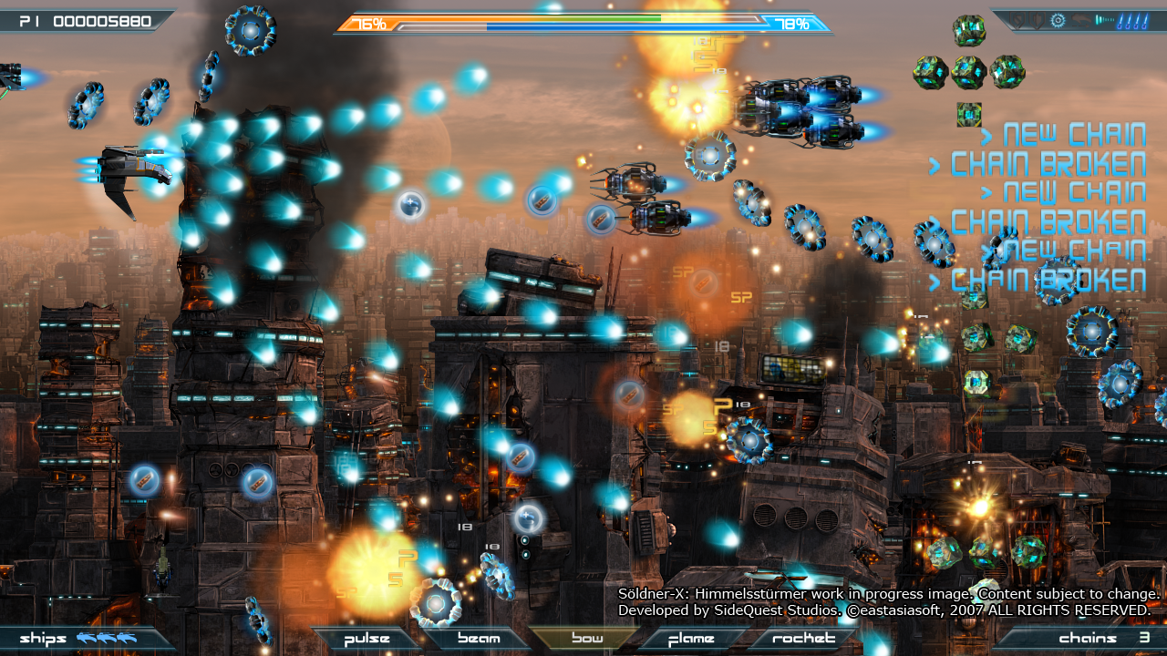
Landscape Gameplay
Left to right

Slide 8
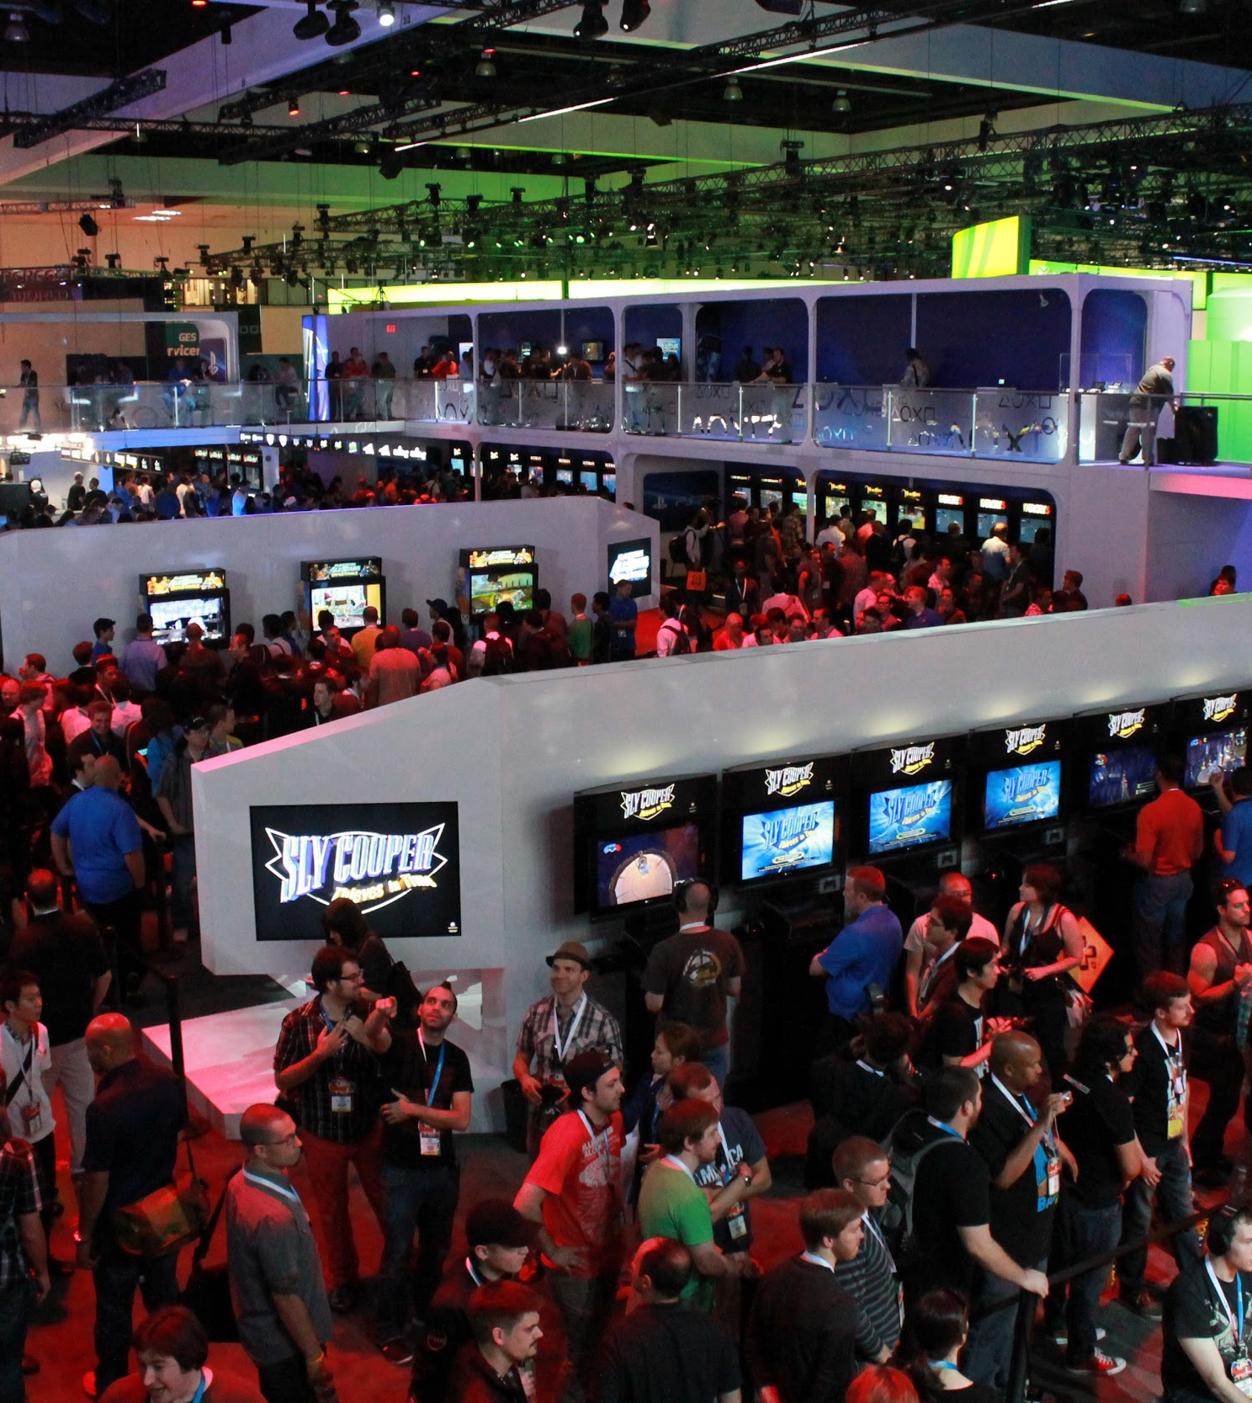
Player
Power-Ups
Different ship models based on score
Fast and Quick enjoyable experience
Designed for the Gamer on the go
Notes:
https://github.com/Tb64/COMP380/tree/master/Compiled

Slide 9
Enemy
Enemy Spawner
Enemy Children
Enemy Superclass
Spawns the enemy and controls the flight path.
Code of unique enemy skills.
Class that all enemies will have. For fast implementation.

Slide 10
Level model
Intro Scene
Combat
Exit Scene
The levels will be designed for a 2 minute experience per level. With about 10 seconds decided to an intro scene and exit scene. Such as flying in and out of the level.

Slide 11
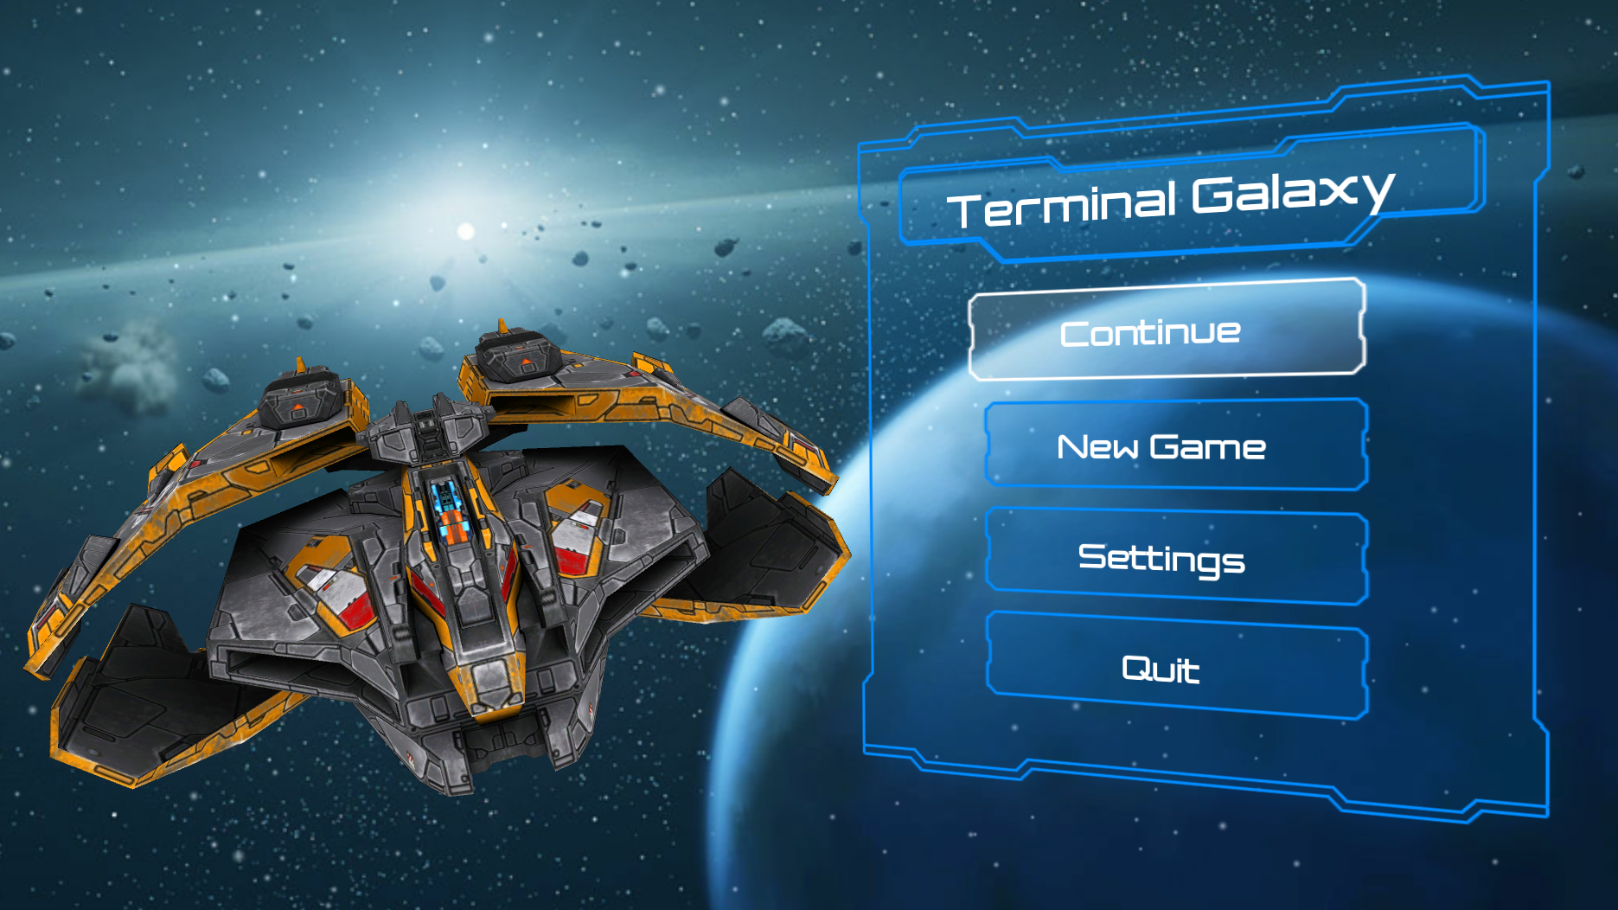
Closing
A 6 week project that will lean teach us tools of collaboration. While also giving us a deliverable game. Ask for a demo!
Notes:
https://github.com/Tb64/COMP380/tree/master/Compiled - Demo

Slide 12
Alternative Ideas
-Social Media Platform
-Password cracker using permutations

Slide 13
Meet the Team
-Dillon Hour
-Damian Linares
-Tuan Bui
-Arthur Zaragaryan
-Phu Nguyen
-Moises Zurita
-Ahmed Al Balushi

